Slide 1
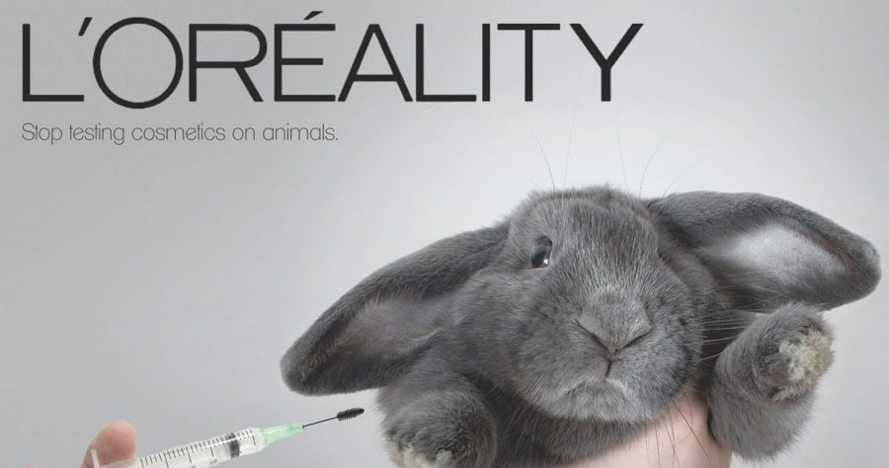
Technology Used In Animal Testing
Example: The Cosmetic Industry
By: Brooke Puccio

Slide 2
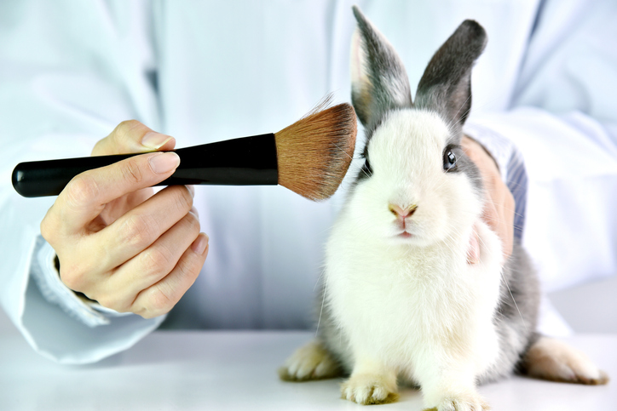
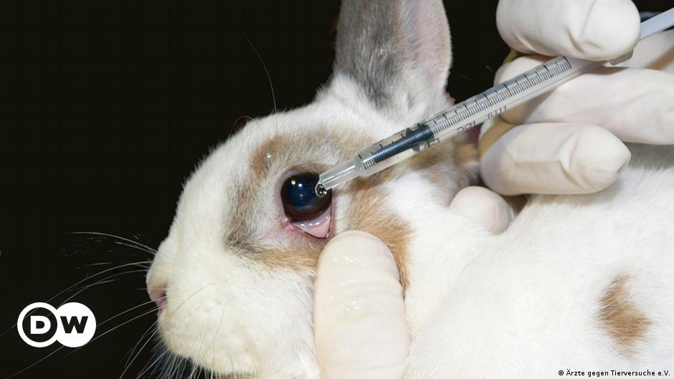
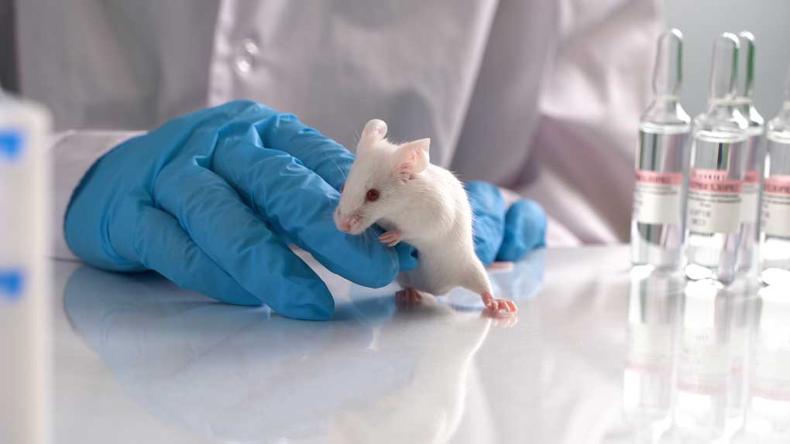
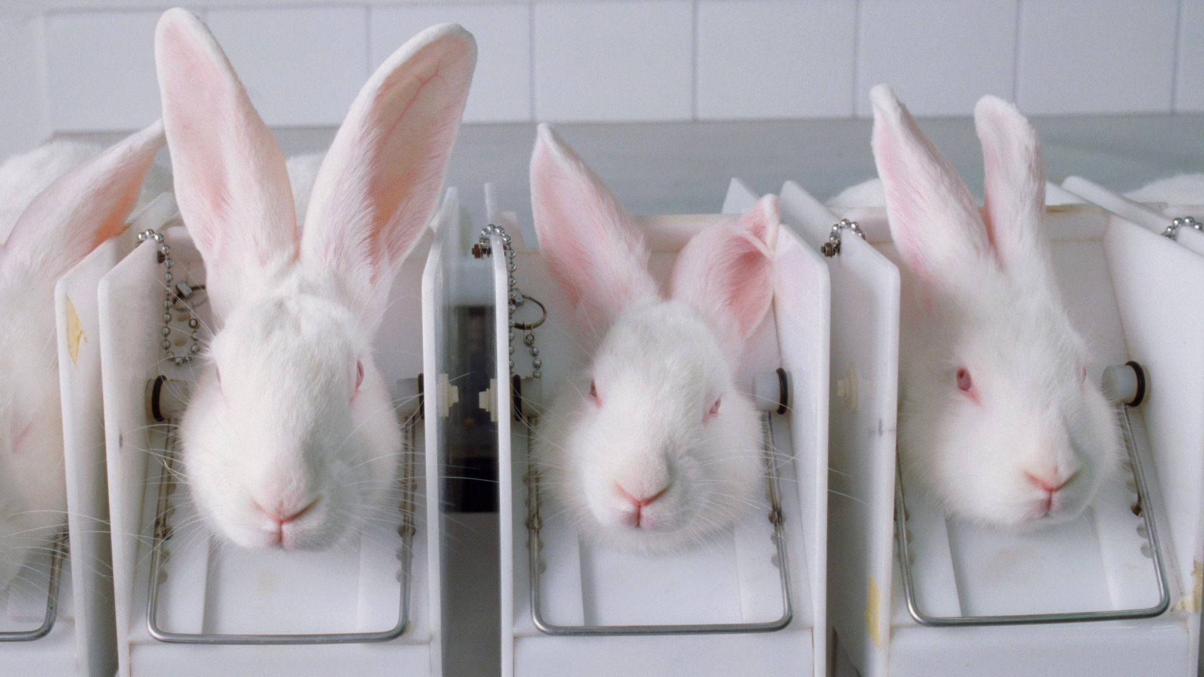

Slide 3
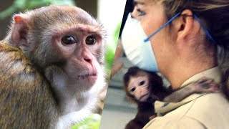

Slide 4
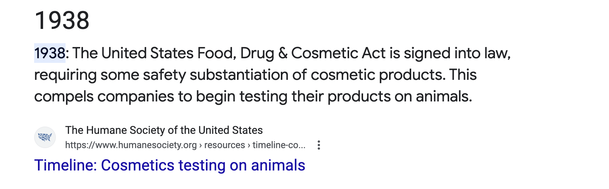
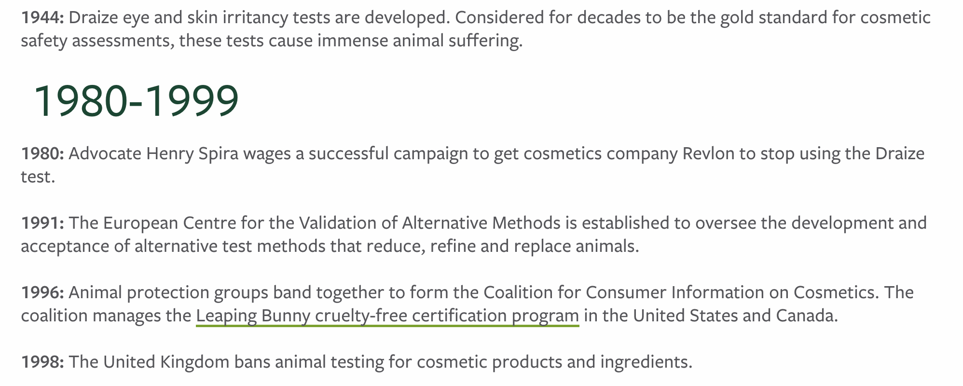

Slide 5
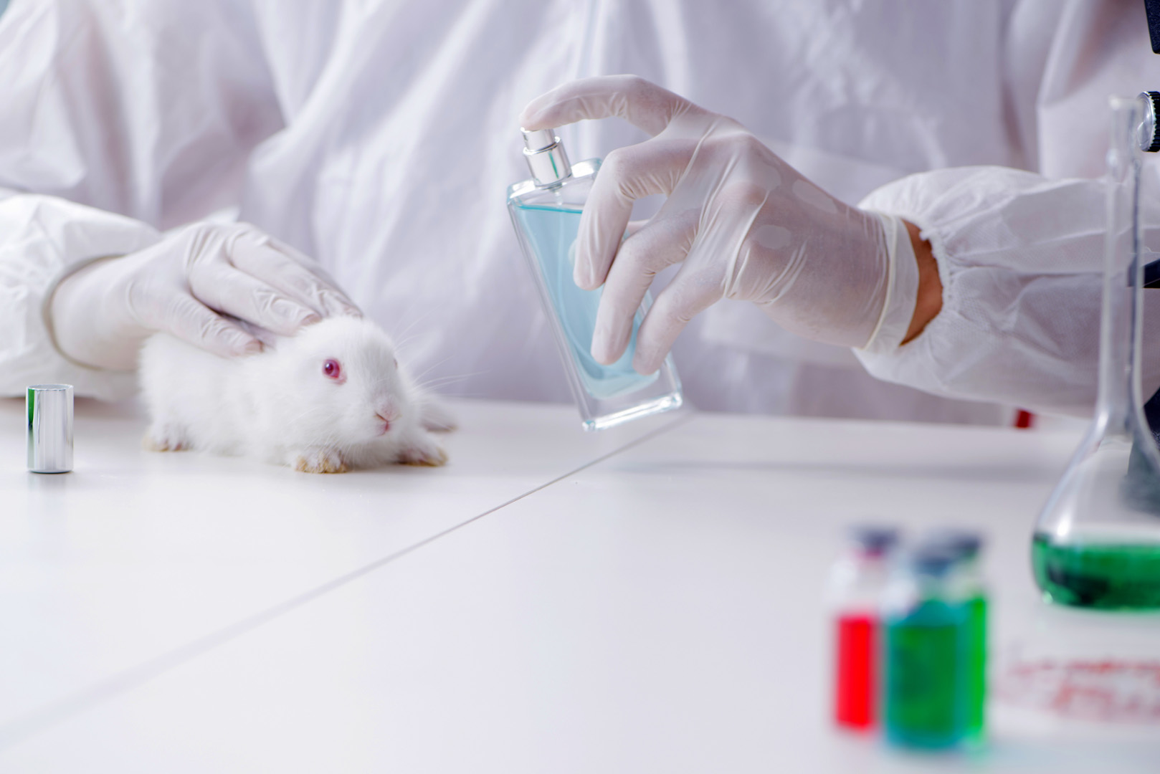
Animal testing in the cosmetic industry has been a contentious issue for decades
Animals being used in this practice include rabbits, mice, and rats.
The animals are used for testing the safety and efficacy of cosmetic products before they can be marketed to customers.
These tests can cause animals to experience severe pain, distress, and even death.
Animal testing in the cosmetic industry is ethically wrong for several reasons
The industry is now exploring alternative methods to ensure the safety and efficacy of its products.
“At least 115 million animals are thought to be used for scientific purposes every year, worldwide”(Herrmann, et. al, 2019, p.585)

Slide 7
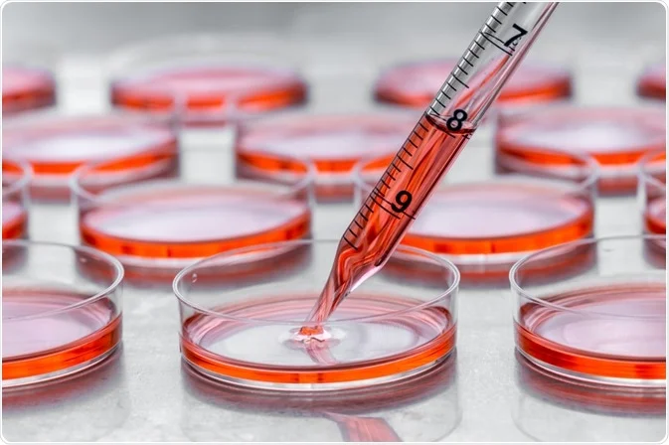
In Vitro Testing
In vitro testing involves testing cosmetics on human cells or tissues grown in a lab
This method allows for more accurate predictions of human responses to a product than animal testing
In vitro testing is widely used to test the safety of cosmetic ingredients
Vitro testing is very effective at checking a cosmetic product acute toxicity.
This method is more effective in predicting the safety and efficacy of cosmetic products than animal testing.
“All accepted methods for determining acute oral toxicity are based on in vivo experiments after the single administration of a few doses and estimation of the dose causing the death in 50% of the animals”(Vinardell, 2017, pg. 1).

Slide 8
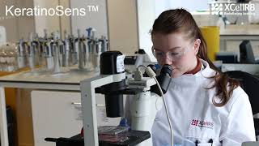

Slide 9
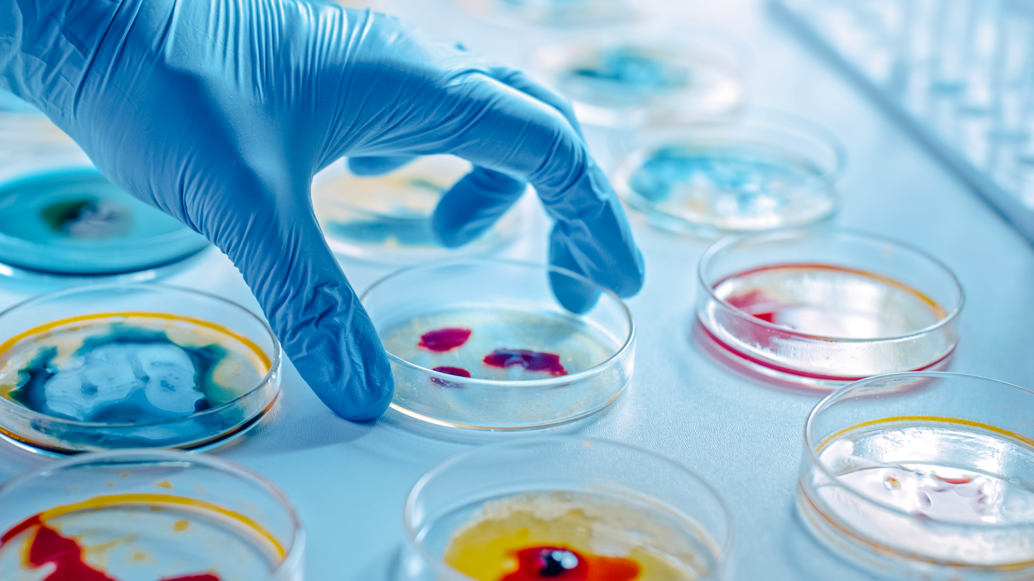
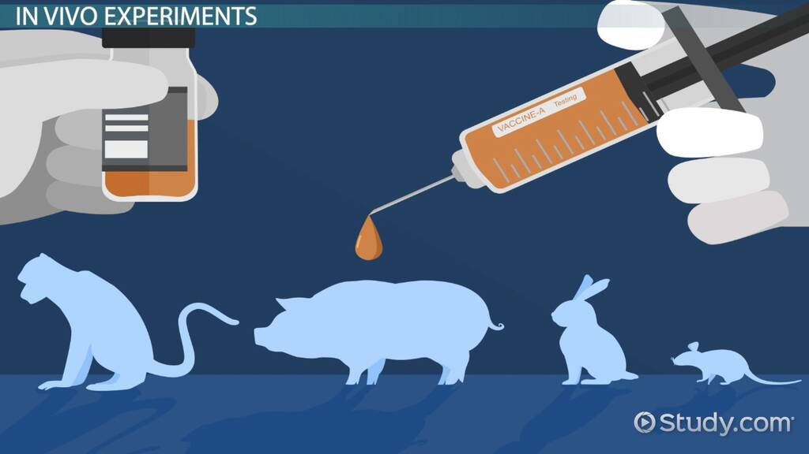
When labs used in vivo (animals) to test cosmetic’s acute toxicity more than 50% of animals died due to the dosage received.

Slide 10
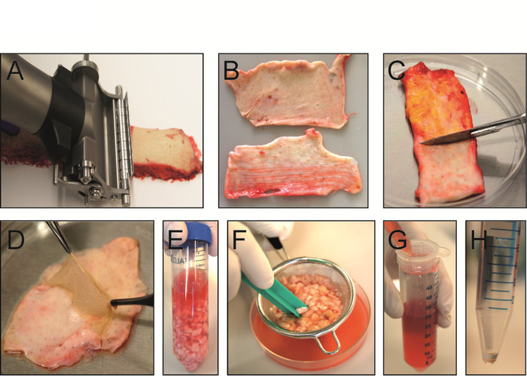
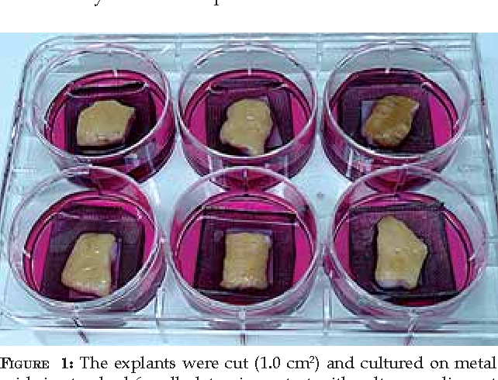
Skin Explants
The skin explant are small pieces of human skin that are removed during surgery
These explants can be used to study the effects of cosmetics on human skin
This method is particularly useful in testing the penetration and distribution of a cosmetic product on the skin

Slide 11
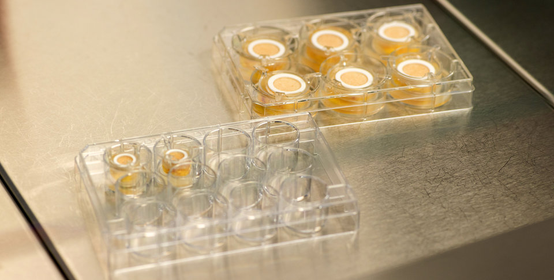
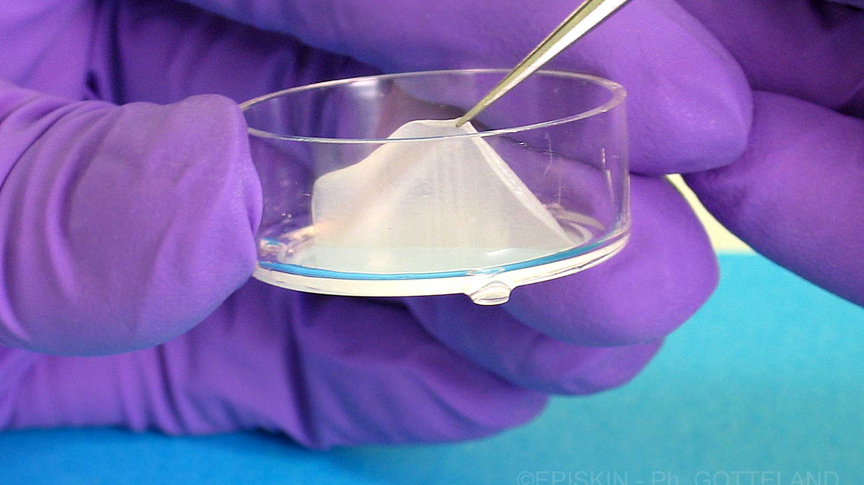
Artificial Skin
Artificial skin is a product that simulates human skin and can be used to test cosmetics. It is made from materials such as silicone or collagen and can be used to test the efficacy and safety of cosmetics.

Slide 12
Technology Used In
Animal Testing
https://youtu.be/vM74dBDdJyg?si=TsM8PT3UszTsVBjZ

Slide 13
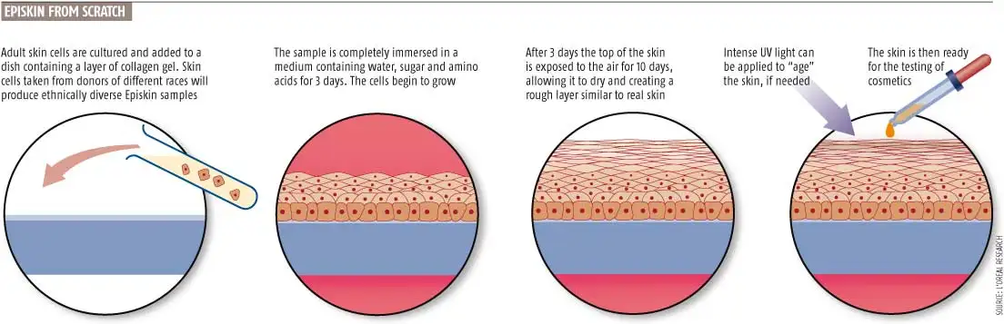

Slide 14
Animal testing is not always reliable, even though animal testing has been used for decades it is not always a reliable indicator of how a product will affect humans. This is why artificial skin and skin-explants are great alternatives. Animals have different anatomies and physiological processes than humans, making their responses to cosmetic products unpredictable. For example, a cosmetic product may be safe for rats or rabbits but can cause severe allergic reactions or skin irritation in humans.

Slide 15

Human Volunteers
Human clinical trials involve testing cosmetics on human volunteers
This method is more reliable and accurate than animal testing because human volunteers are more likely to have similar reactions to cosmetics as the general population
Human clinical trials are particularly useful in testing the efficacy of cosmetics.
animals have just as many rights as humans do, the animals are not given a choice whether or not they're tested on.

Slide 17
